Slide 1
Data Management for Analytics Presentation
Submitted to : Xuemin Jin
Northeastern University

Slide 2



IE 6700 DATA MANAGEMENT FOR ANALYTICS
MediMart
Digital Pharmacy Inventory and Order Management System
GROUP 7 PROJECT PRESENTATION
PROJECT MEMBERS :
DEEPSHIKHA SONI
CHANDINI NEKKANTI

Slide 3
Background information and Business problem
Background information :
In today's fast-paced world, online services are crucial, especially in healthcare. The pharmaceutical industry is shifting towards secure online platforms, and our project, "MediMart," meets this demand with an Online Pharmacy Inventory and Order Management System.
Traditional pharmacies struggle with manual processes, causing errors in inventory and patient engagement. In the digital era, innovation is crucial, and Medicart is our solution. It uses advanced technology to transform pharmacy operations, ensuring efficiency, and providing an improved patient experience through digital tools and services.
Business problem:
The traditional pharmacy model faces several challenges, including manual processes, inefficiencies in inventory management, errors in order processing, and limited patient engagement. These challenges can lead to stockouts, wastage, and reduced overall customer satisfaction. The business problem that Medicart addresses includes:
1. Inefficient Inventory Management:
2. Order Processing Challenges.
3. Limited Patient Engagement.
4. Operational Inefficiencies.
5. Competition and Customer Expectations.

Slide 4
Business requirements
Our "MediMart" Online Pharmacy Inventory and Order Management System should have the following functionalities and features:
1. User Authentication and Authorization: The system should have a secure user authentication mechanism for doctors, employees, and patients.
2. Product Management: Categorization of products based on type, brand, and other relevant attributes.
3. Order Processing: Secure order placement for patients, with processing by employees. Integration with electronic prescriptions for accurate order processing. Order status tracking for both patients and pharmacy staff.
4. Patient Engagement: User-friendly patient interface for browsing products and placing orders.
5. Consultant Doctor Interaction: Integration of doctor recommendations into the patient's order and prescription history.
6. Employee Management: Role-based access control for pharmacy staff, including employees processing orders.
7. Cart and Order Details: Detailed order summaries including product details, quantities, and total cost.
8. Payment Processing: Storage of payment details in the payment entity linked to the order.
9. Delivery and Pickup Services: Integration with delivery services for home delivery of medications. Order pickup management for patients who prefer to collect medications from the pharmacy.
10. Security and Compliance: Implementation of robust security measures to protect patient and payment data.

Slide 5
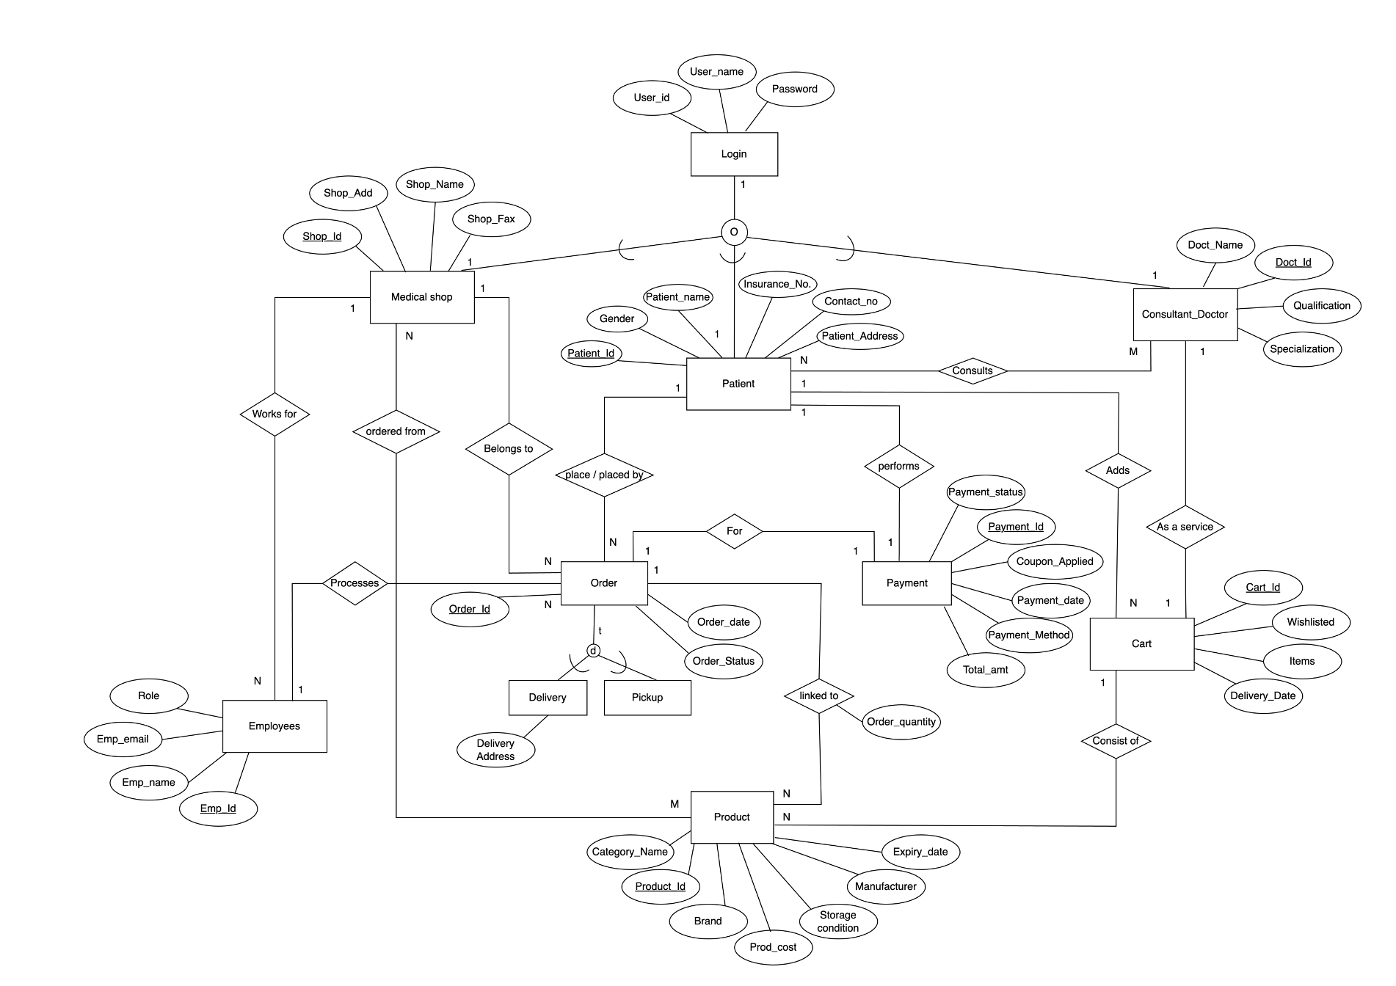
Conceptual data model (EER)

Slide 6
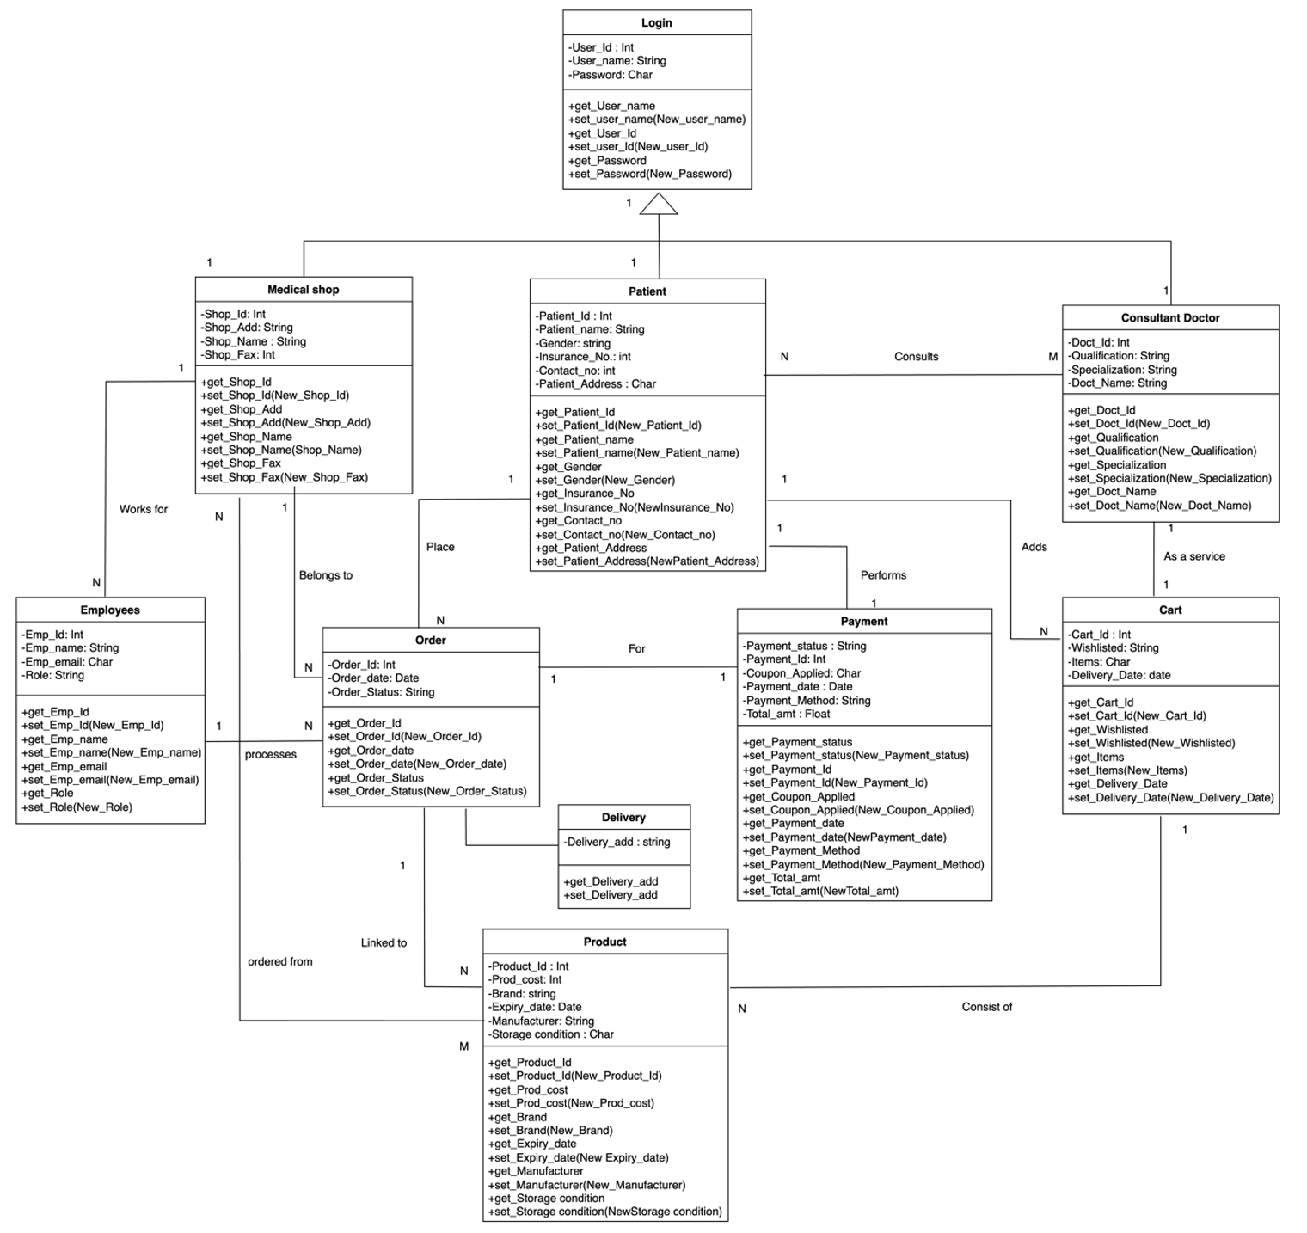
Conceptual data model (UML)

Slide 7
Relational model (LOGICAL DATA MODEL)
1. Login (User_ID, User_Name, Password) Primary Key: User_ID , Null not allowed
2. Medical Shop (Shop_ID, Shop_add, shop_name, shop_fax, login_ID)
Primary Key: Shop_ID, Foreign Key: login_ID refers to primary key of relation login, Null not allowed
3. Consultant_Doctor (Doc_ID, Doc_Name, Qualification, Specialization, login_ID)
Primary Key: Doc_ID, Foreign Key: login_ID refers to primary key of relation login, Null not allowed
4. Employees (Emp_ID, Emp_Name, Emp_Email, Role, Shop_ID)
Primary Key: Emp_ID , Foreign Key: Shop_ID refers to primary key of relation Medical Shop, Null not allowed
5. Delivery (Delivery Address, Order_ID, order_date, order_status, shop_ID, Patient_ID)
Foreign Key: Order_ID refers to primary key of relation Order, Shop_ID refers to primary key of relation Medical Shop, Pateint_ID refers to primary key of relation Patient, Null not allowed
6. Pickup (Order_ID, order_date, order_status, shop_ID, Patient_ID) Foreign Key: Order_ID refers to primary key of relation Order, Shop_ID refers to primary key of relation Medical Shop, Pateint_ID refers to primary key of relation Patient, Null not allowed
7. Patient (Patient_ID, gender, Patient_Name, Insurance_No, Contact_No, Patient_address, shop_ID, login_ID, Doc_ID )
Primary Key: Patient_ID
Foreign Key: login_ID refers to primary key of relation Login, Shop_ID refers to primary key of relation Medical Shop, Doc_ID refers to primary key of relation Consultant Doctor, Null not allowed

Slide 8
Relational model (LOGICAL DATA MODEL)
8. Payment (Payment_ID, payment_status, coupon_applied, payment_date, payment_metod, total_amt, order_id, Patient_ID)
Primary Key: Payment_ID
Foreign Key: Order_ID refers to primary key of relation Order, Pateint_ID refers to primary key of relation Patient, Null not allowed
9. Cart (cart_ID, whislisted, items, Delivery_date, Patient_ID, Doc_ID)
Primary Key: cart_ID
Foreign Key: Pateint_ID refers to primary key of relation Patient, Doc_ID refers to primary key of relation Consultant Doctor, Null not allowed
10. Product (product_ID, category name, brand, prod_cost, storage condition, manufacturer, Expiry_date, order quantity, Cart_ID, Order_ID)
Primary Key: Product_ID
Foreign Key: cart_ID refers to primary key of relation cart, Order_ID refers to primary key of relation Order, Null not allowed
11. Ordered_from (Shop_ID, Product_ID) Foreign Key: Shop_ID refers to primary key of relation Medical Shop, Product_ID refers to primary key of relation Product, Null not allowed
12. Consults (patient_ID, Doc_ID)
Foreign Key: Pateint_ID refers to primary key of relation Patient, Doc_ID refers to primary key of relation Consultant Doctor , Null not allowed

Slide 9
THANKYOU

